Slide 1

Secure data hiding in image using steganography
Cyber Security Jan-2025
Presented By-
Student Name:
Anjali Khatawkar
Department & College Name:
Information Technology,
A C Patil College of Engineering,
Navi Mumbai, Maharashtra

Slide 2
OUTLINE
Problem Statement
Technology used
Wow factor
End users
Result
Conclusion
Git-hub Link
Future scope

Slide 3
Problem Statement
In today's digital age, the need for secure communication is important. While encryption offers a degree of security, it often flags suspicion due to its nature. This project addresses the challenge of hiding sensitive data within seemingly harmless images, ensuring discreet transmission and minimizing the risk of detection.

Slide 4
Technology used
Programming Language: Python
Image Processing Library: OpenCV
Graphical User Interface (GUI): Tkinter
File Handling & Security: Basic encryption logic for password protection
Code Editor: VSCode
Operating System: Windows 11

Slide 5
Wow factors
The "wow" factor of this project lies in its ability to conceal data within images without leaving any noticeable traces. A casual observer would perceive the image as completely normal, unaware of the hidden information.

Slide 6
End users
Journalists and Whistleblowers: For secure communication and protection of sources.
Activists and Human Rights Defenders: For organizing and disseminating information in restrictive environments.
Businesses: For secure transfer of sensitive data, intellectual property, or confidential communications.
Individuals: For private and secure sharing of personal information.
Government and Law Enforcement: For covert operations and secure communication.

Slide 7
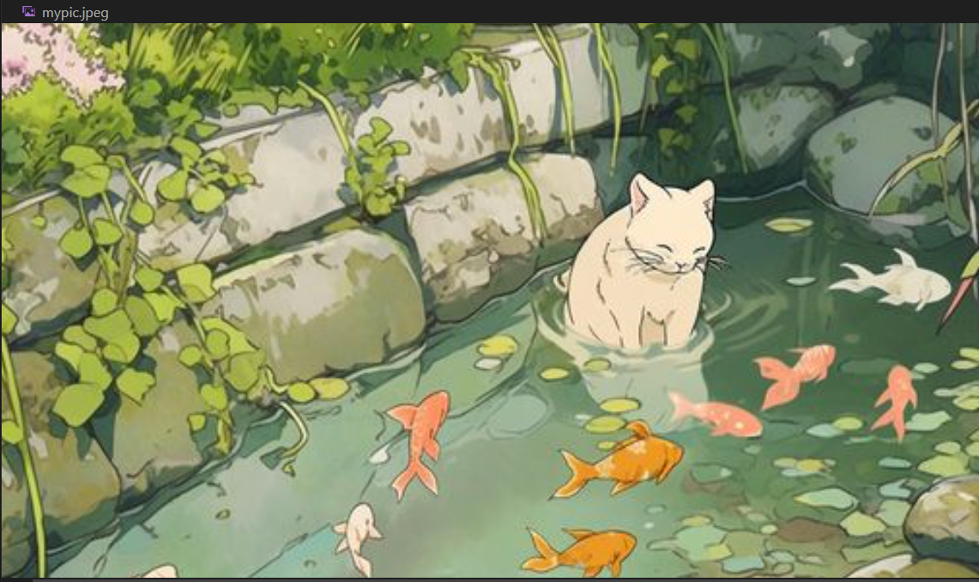
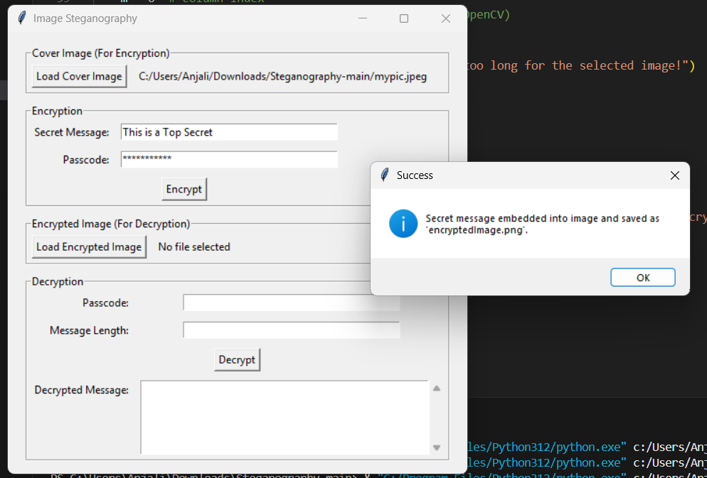
Results
Screenshots of the outcome (min 3)

Slide 8

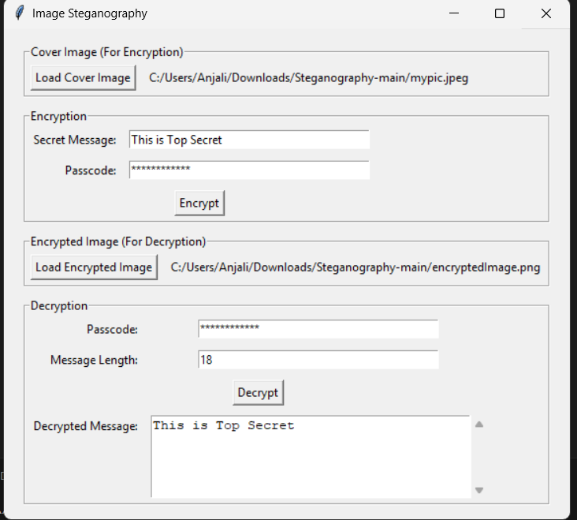

Slide 9
Conclusion
Hence, have demonstrated the ability to hide data within images without compromising their visual integrity. This technology offers a viable alternative to traditional encryption methods in situations where covert communication is essential,

Slide 10
GitHub Link
https://github.com/anj0li/Steganography

Slide 11
Future scope
Expanding beyond images : Support for Audio and Video Steganography.
Detection Prevention: Undetectable from modern forensic tools like AI and Quantum Computers.
Multi-Layer Security: Combining steganography with blockchain and other security configurations for ultimate security in communication.

Slide 12
THANK YOU

